Slide 1

DATA ANALYTICS AND VISUALIZATION(24DSB3101)
An Explainable AI Framework for Multimodal Big Data Analytics in Smart Transportation Systems
Batch – 12
2420030554 – Y. Paavana Pranavasri
2420030394 – K. Bhavya
2420030416 – A. Divya Sree
2420030677 – J. Sree Vardhini

Slide 2
Methodology:
1. Multimodal Data Collection & Integration
→ Satisfies Objective 1
Collect public transport, road accident, and climate/weather datasets.
Clean and preprocess the datasets.
Standardize relevant attributes and prepare them for combined analysis.
2. Exploratory Data Analysis & Visualization
→ Satisfies Objective 2
Analyze trends and patterns in accident, transport, and weather data.
Identify relationships between transportation and environmental factors.
Use statistical analysis and visualizations to identify important risk factors.

Slide 3
Methodology:
3. Feature Engineering & Machine Learning
→ Satisfies Objective 3
Create meaningful features from the processed datasets.
Train machine learning models to predict road-safety/transportation risk outcomes.
Use SHAP and LIME to explain the factors influencing model predictions.
4. Model Performance & Explainability Evaluation
→ Satisfies Objective 4
Evaluate classification models using Accuracy, Precision, Recall, and F1-score.
Analyze the confusion matrix and model execution/response time.
Evaluate feature importance and SHAP/LIME explanations.
Identify the major factors influencing predictions.

Slide 4
Data Collection & Preprocessing:
Road Accident Dataset
State-wise accident data
Accident records from 2019–2023
Ranking and percentage-change information
Transport Dataset
City-wise bus information
Bus types
Bus terminals, stands and stops

Slide 5
Data Collection & Preprocessing:
Weather Dataset
Daily weather information
Temperature
Precipitation
Wind speed and gusts
Weather conditions
Preprocessing
Missing-value handling
Duplicate removal
Data type conversion
Dataset cleaning
Standardized dataset structure

Slide 6
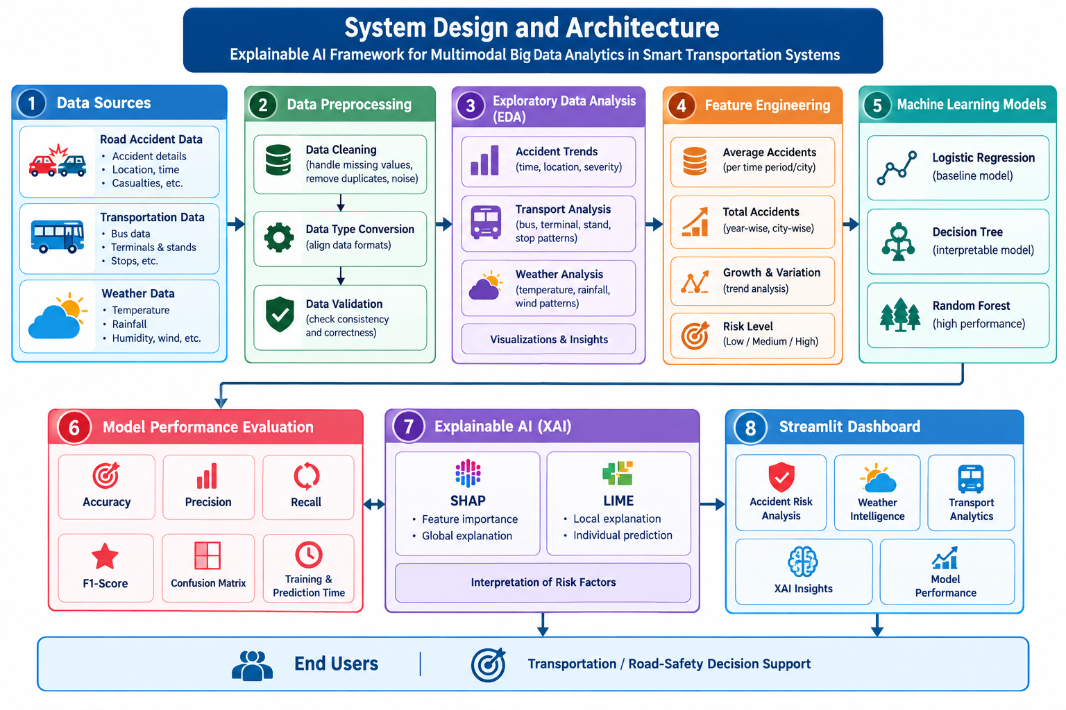
System Design:

Slide 7
Modern Tools & Technologies:
Programming: Python 3
Data Processing: Pandas, NumPy
Machine Learning: Scikit-learn
Models: Logistic Regression, Decision Tree, Random Forest
XAI: SHAP, LIME
Visualization: Matplotlib, Plotly
Dashboard: Streamlit
Development: VS Code, Python Virtual Environment

Slide 8
Implementation – Machine Learning Models:
Models trained for road-accident risk prediction:
Logistic Regression – baseline classification model for risk prediction.
Decision Tree – interpretable rule-based model for identifying risk patterns.
Random Forest – ensemble model used for robust accident-risk classification.
Each model is trained using the same processed accident dataset and evaluated using Accuracy, Precision, Recall, and F1-Score for a fair performance comparison.

Slide 9
Implementation – Explainability (SHAP & LIME) :
SHAP – Global Explainability
Calculates feature contributions to understand their influence on risk predictions.
Identifies the most important accident-related features affecting the model.
LIME – Local Explainability
Explains an individual risk prediction using local feature contributions.
Shows why the model classified a particular case as Low, Medium, or High risk.
Both techniques are integrated into the framework to provide transparent and interpretable machine learning predictions.

Slide 10
Implementation – BI Dashboard (Streamlit) :
The dashboard is developed using Streamlit and provides an interactive web-based interface for smart transportation analytics.
Modules implemented:
Live Command Center – overall transportation and safety overview.
Smart Route – route-oriented transportation risk information.
Accident Risk – accident-risk prediction and analysis.
Weather Intelligence – temperature, rainfall and weather analysis.
Transport Intelligence – public transport and infrastructure insights.
Explainable AI – SHAP and LIME prediction explanations.
Model Performance – model metrics, confusion matrix and evaluation results.
The dashboard integrates data analysis, machine learning, explainability, and visualization into a single platform for transportation and road-safety analysis.

Slide 11
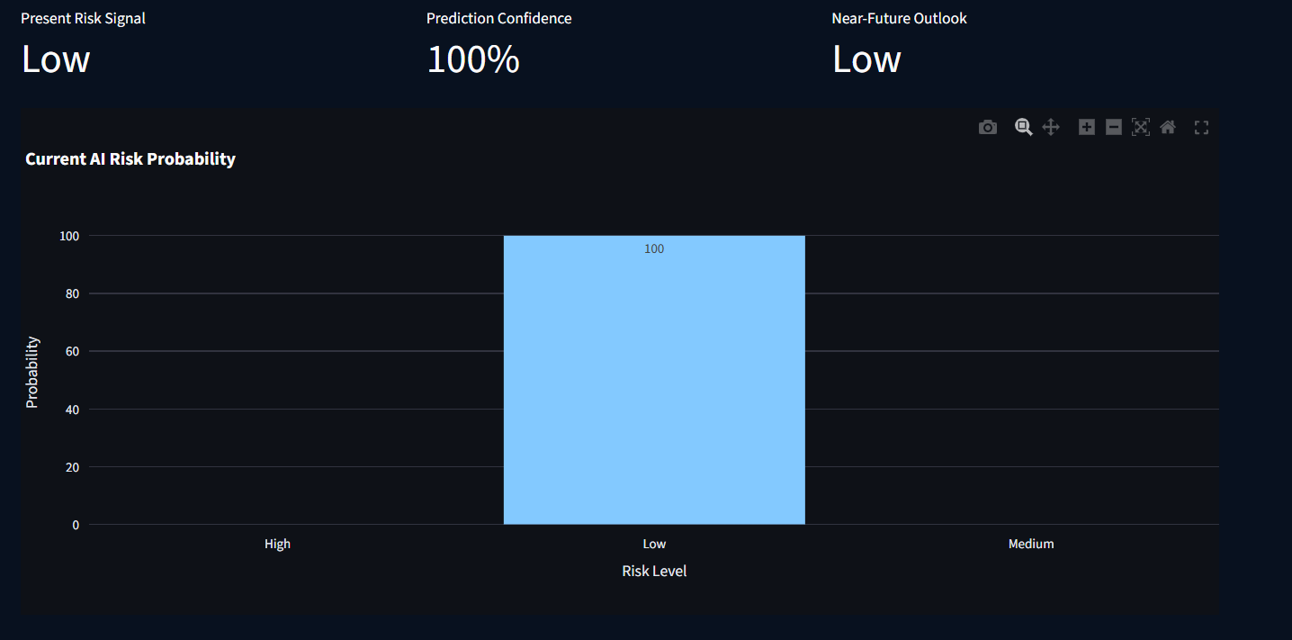
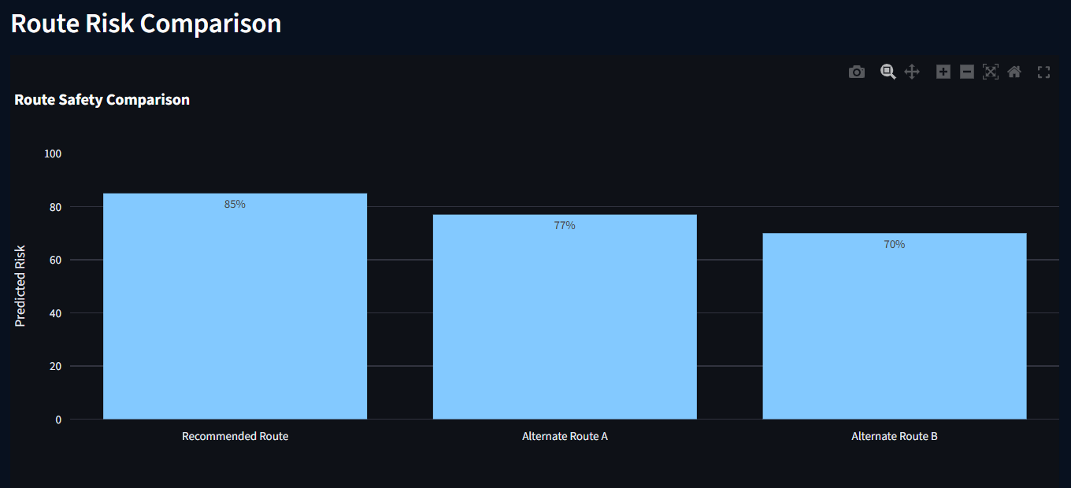
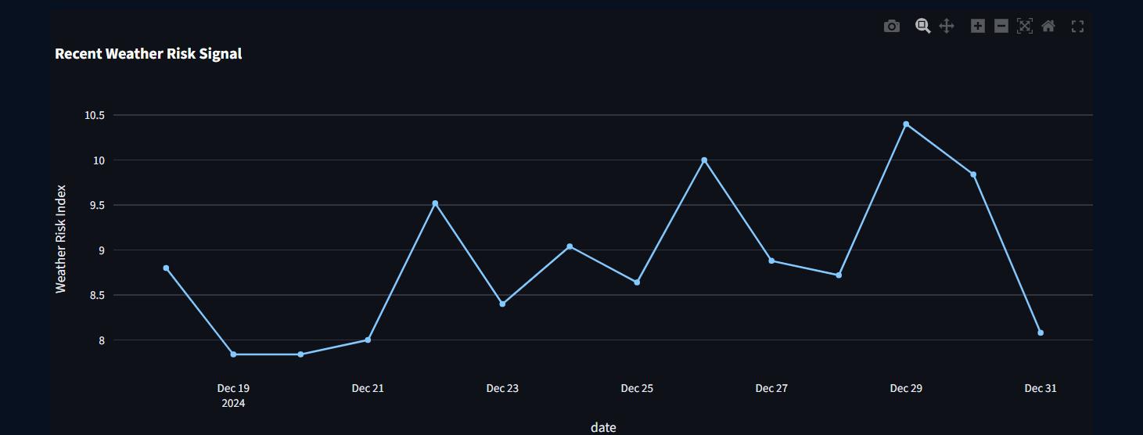
Results:

Slide 12
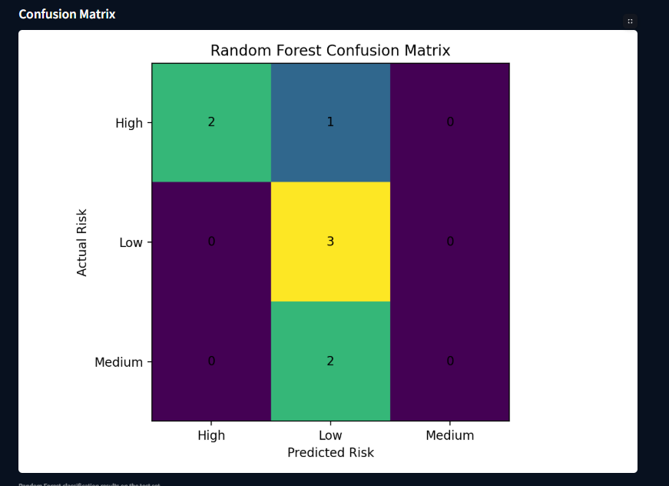
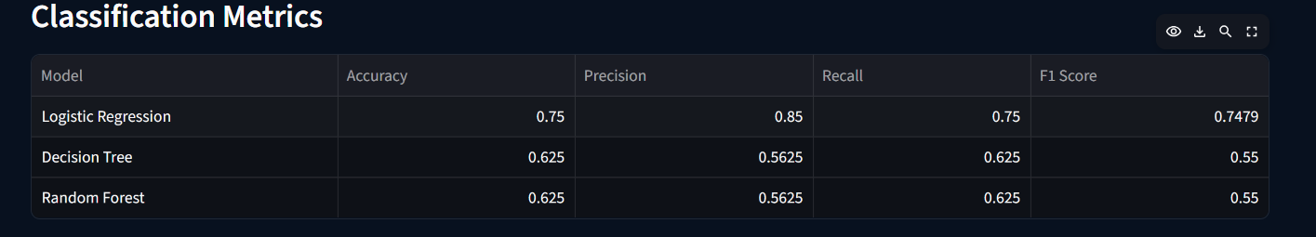
Results:

Slide 13
Performance Evaluation & Key Findings:
Performance Evaluation
Models: Logistic Regression, Decision Tree, Random Forest
Metrics: Accuracy, Precision, Recall, F1-score & Confusion Matrix
Efficiency: Training and prediction response time
XAI: SHAP & LIME for prediction explanations
Datasets: Completeness, coverage and statistical analysis
Key Findings
Decision Tree and Random Forest achieved higher F1-scores than Logistic Regression.
Accident-history features effectively contributed to Low, Medium and High risk classification.
SHAP and LIME identified important factors influencing model predictions.
Road accident, transport and weather datasets revealed useful transportation and safety patterns.
The Streamlit dashboard integrates analysis, prediction and explainability into one interface.

Slide 14
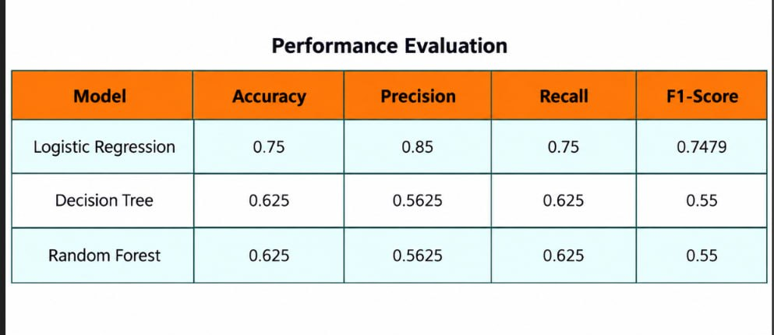
Performance Evaluation:

Slide 15
Novelty:
Multimodal Framework: Integrates road accident, public transport, and weather data within a single analytics framework.
Risk-Level Prediction: Classifies road-safety risk into Low, Medium, and High categories using machine learning.
Explainable AI: Combines SHAP and LIME to explain why a particular risk prediction is generated.
Integrated Decision Dashboard: Presents analytics, risk prediction, model performance, and explanations through an interactive Streamlit dashboard.
Data-Driven Safety Insights: Connects accident patterns with transportation and environmental information to support interpretable transportation safety analysis.

Slide 16
Conclusion & Future Scope:
The proposed Explainable AI Framework for Multimodal Big Data Analytics in Smart Transportation Systems provides an integrated approach for analyzing road accident, public transport, and weather data. Machine learning models are used for accident-risk classification, while SHAP and LIME improve the interpretability of predictions. The Streamlit dashboard brings the analytical results, risk prediction, model performance, and explanations together in an interactive interface, supporting data-driven transportation and road-safety analysis.
The framework can be extended by integrating real-time traffic and IoT sensor data, GPS and geospatial information, and larger datasets from multiple sources. Future work can also explore additional machine learning and deep learning models, real-time risk alerts, route-risk analysis, and cloud-based big-data processing. These enhancements could help move the framework toward real-time smart transportation and road-safety decision support.

Slide 17
Thank You

